Slide 1

Veterinarian Hospital Wait Times
Machine Learning Regression Case Study
Amie Davis, amodavis@my365.bellevue.edu, DSC680, Bellevue University, 5 May 2021

Slide 2
Overview
Business Problem
Exploratory Data Analysis
Special Interest Questions
Target Variable Calculation
Modeling Objective
Model Results
Wait Time Estimator
Recommendations

Slide 3
Business Problem
Estimated Wait Times Unknown
The demand for emergency treatment of pets has created a backlog in veterinarian hospitals. Although facilities are staffed 24 hours 7 days a week, they are unable to keep up the pace. Customers have to wait with their pets an uncomfortable amount of time and get impatient without knowing how long they can expect to wait.

Slide 4
Business Objective 1
Let clients know anticipated wait time

Slide 5
Business Objective 2
Understand factors that contribute to longer wait
time so they can be mitigated

Slide 6
Special Interest Questions
How many patients in the waiting room when a customer leaves?
What is the average patient count in the waiting room during normal office hours?
When are the best/worst times to book an appointment?
Has there been an increase in the number of patients waiting since the pandemic?
How many urgent (“stat”) cases are seen a day?
What is the maximum/average/minimum number of patients treated in each department?

Slide 7

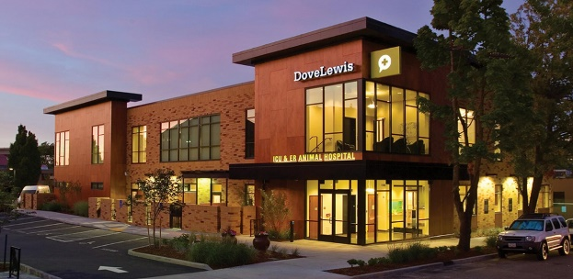
Data Source
Datasets provided by DoveLewis Veterinary Emergency & Specialty Hospital
Whiteboard Records
Outpatient and ICU waiting area snapshots in 5-minute increments
Patient Records
Appointment details
Smart Flow Wait Records
Existing wait time estimator tool results
Known to be inaccurate
Not customized to the facility or domain

Slide 8
Data Summary
181,742 Whiteboard Records
Features: Outpatient Count, ICU Patient Count, Time Stamp
74,529 Weekly Patient Records
Features: Department, Consult Date, Consult Division, Triage Type, Clinical Description, Appointment Type, Appointment Date, Presenting Problem, Therapeutic-Procedure
64,032 Smart Flow Wait Records
Features: Time Stamp, Patient Count, Wait Time Average

Slide 9
Descriptive Statistics Observations
Weekly Patient Records were missing several data elements
68,291 Records missing Triage Type
Hospital did not start tracking Triage Type until 4 Jan 2021
Triages are tracked for emergency room only
26 Records missing Appointment Type
89 Records missing Appointment Date
74,422 Records missing Presenting Problem
56,511 Records missing Procedure

Slide 10
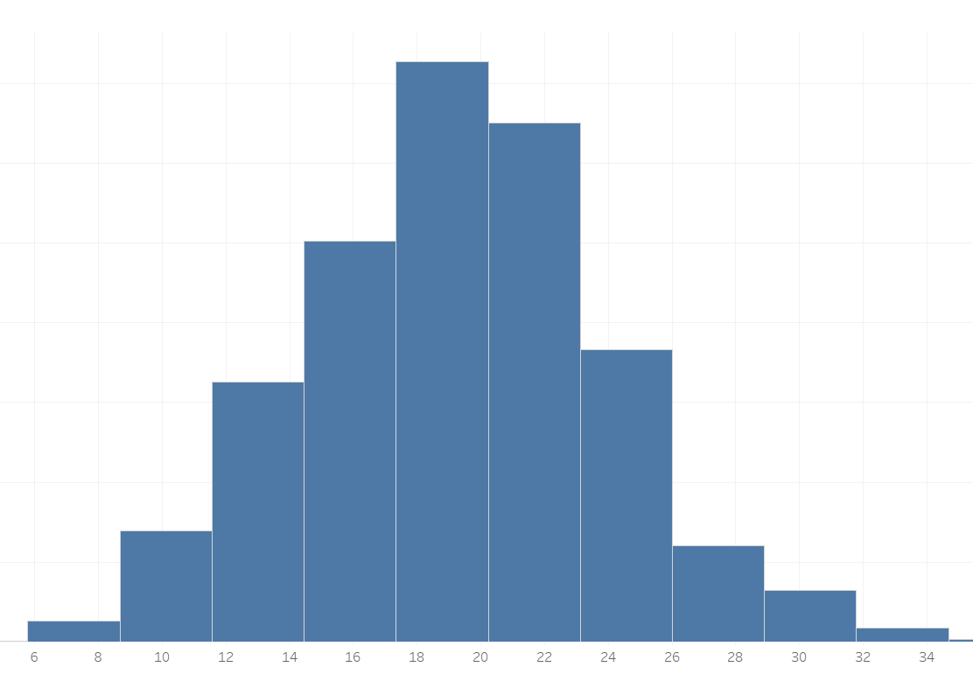
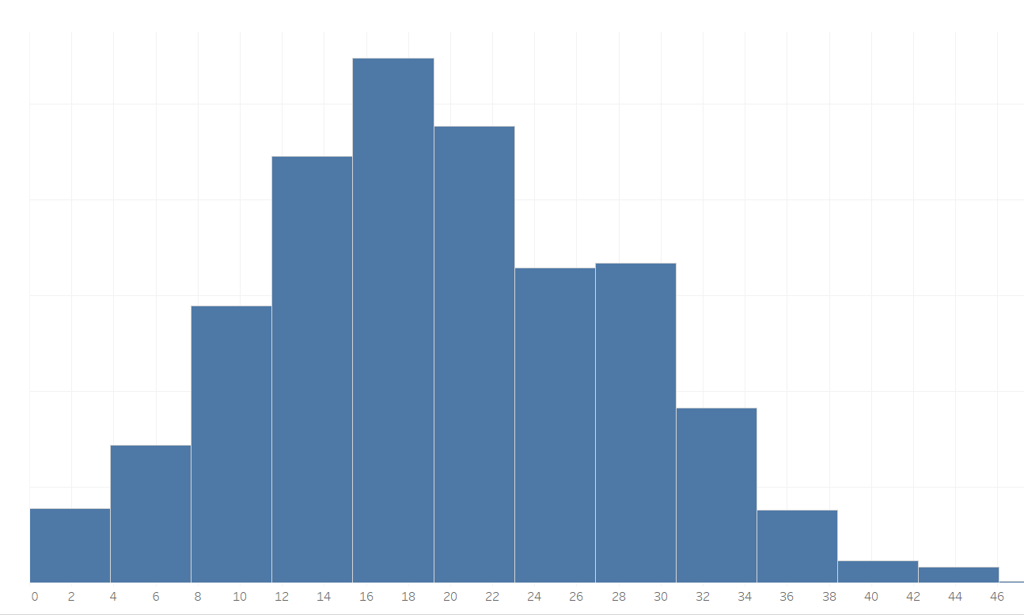
Distributions
Number of Patients Waiting Normally Distributed
ICU Waiting Room
Outpatient Waiting Room

Slide 11
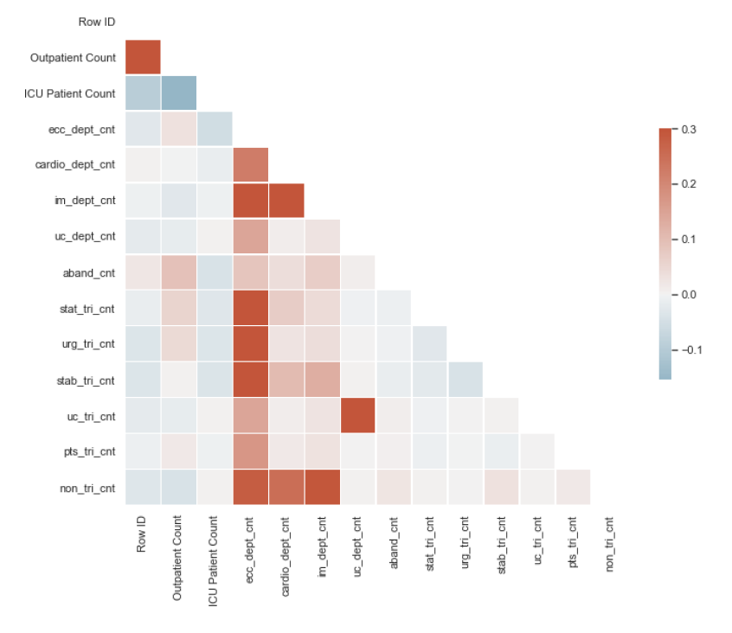
Feature Correlation
Correlation Coefficient
Notes:
Pearson’s Correlation Coefficient

Slide 12
Data Analysis
How many patients in the waiting room when a customer leaves?

Slide 13
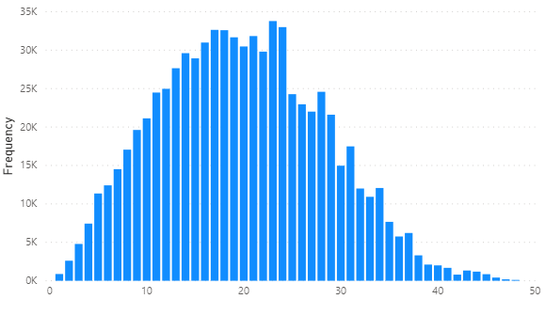
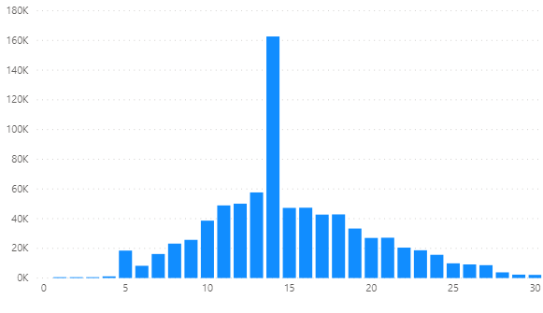
Patient Abandonment
Normally distributed
Outpatient peak abandonment at 23 patients waiting
ICU peak abandonment at at 14 patients waiting
Outpatient
ICU

Slide 14
Data Analysis
2) What is the average patient count in the waiting room during normal office hours?
3) When are the best/worst times to book an appointment?

Slide 15
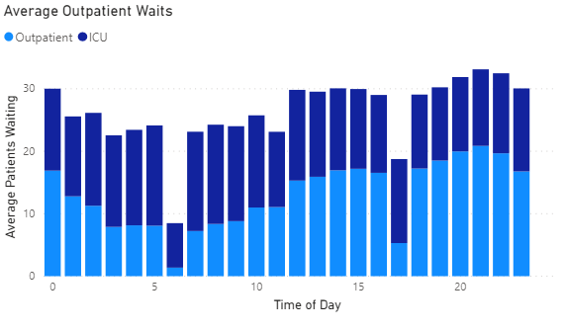
Best Times
6:00 am – 7:00 am
5:00 pm – 6:00 pm

Slide 16
Data Analysis
4) Has there been an increase in the number of patients waiting since the pandemic?

Slide 17
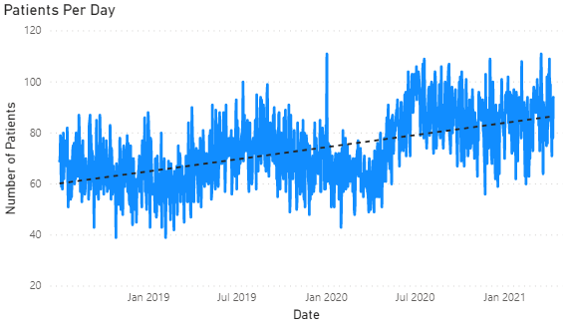
Patient Increase
Overall increase in July 2020
Yet to drop back to pre-pandemic levels

Slide 18
Data Analysis
5) How many urgent (“stat”) cases are seen a day?

Slide 19
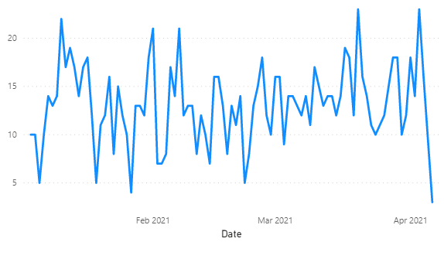
STAT Patients
Varies Daily
Ranges from 3 to 23
Tracking began in 2021

Slide 20
Data Analysis
6) What is the maximum/average/minimum number of patients treated in each department?

Slide 21
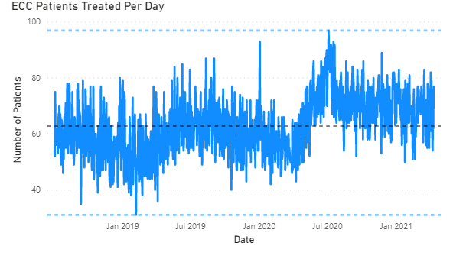
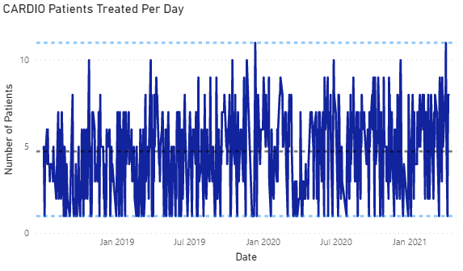
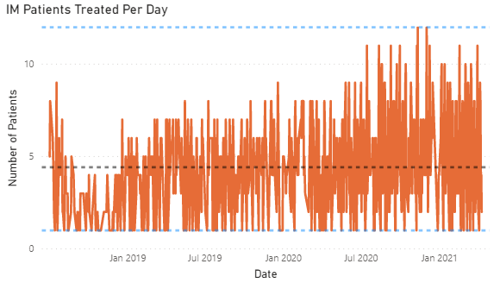
Patients By Department
Most patients in ECC dept (~ 85%)
ECC patients peaked in Jul 2020
CARDIO and IM patients vary day by day
Notes:
ECC=Emergency Critical Care
CARDIO=Cardiology
IM=Internal Medicine

Slide 22
Little’s Law
The average length of a line (L) is the product of the waiting time in line (W) multiplied by the throughput to the system (Lambda)
L = Wλ
or Wait Time = People Waiting/ Number Concurrent Cases treated

Slide 23
Modeling Objective
Perform supervised learning to predict patient throughput
Notes:
Target variable = Throughput

Slide 24
Model Selection
Regression Models
Decision Tree Regressor
Random Forest Regressor
Boosting Regressor

Slide 25
Model Evaluation
Coefficient of Determination (R²)
Model | R²
Decision Tree | -0.38
Random Forest | -0.10
AdaBoost | 0.20
Final Decision Tree | -0.59
Decision Tree far out-performed the remaining models.
Increased R² 55% by adjusting hyperparameters
Final Model Selection: Decision Tree
Notes:
Scikit-Learn

Slide 26
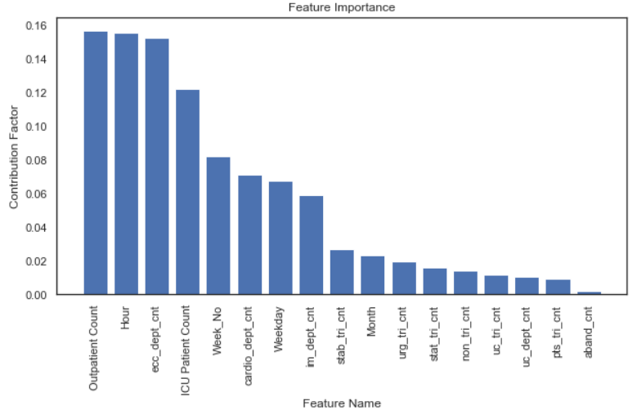
Feature Importance
Four features have over 10% influence on model
Outpatient Count
Time of Day (Hour)
ECC Patient Count
ICU Patient Count

Slide 27
Wait Time Estimator
User enters status of both waiting areas and treatment areas, and the application provides an estimated wait time.

Slide 28
Wait Time Estimator Example
Enter number of patients currently waiting in the Outpatient Waiting Room: 12
Enter number of patients currently waiting in the ICU Waiting Room: 12
Enter number of patients checked in for the ECC Dept: 1
Enter number of patients checked in for the CARDIO Dept: 1
Enter number of patients checked in for the IM Dept: 0
Throughput is expected to be 8 patients per hour.
Current wait time is estimated to be 182 minutes.

Slide 29
Future Recommendations
Start collecting data at each checkpoint
Require problem and procedure data fields
Categorize clinical descriptions
Use Natural Language Processing (NLP) on patient descriptions and treatment notes

Slide 30
The Prediction Effect
The Prediction Effect: A little prediction goes a long way.
- Eric Siegel
Although the accuracy of most of my models were low, value was obtained by determining the importance of features.
Predicting better than pure guesswork, even if not accurately, delivers real value.
- Eric Siegel

Slide 31
References
Kosven, E. (2019, July 14). Finding the Average Wait Time: Little's Law. ISSSP for Lean Six Sigma. https://isssp.org/finding-the-average-wait-time-littles-law/
Siegel, E. (2016). Predictive analytics: The power to predict who will click, buy, lie, or die. Hoboken, NJ: Wiley

